Slide 1

SOCIAL BOOKS GROUP 10
By
Awais Akbar
Karthick Pandi
Yang Wang

Slide 2
TECHNOLOGIES USED

Slide 3
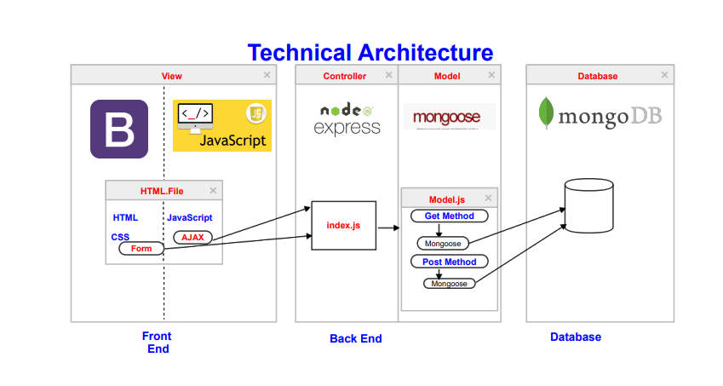

Slide 4
Model - View - Controller
Model : Mongoose
- Managing Relationship between data.
- Schema Validation
- Object representation in MongoDB.

Slide 5
Model - View - Controller
View : HTML, CSS, BootStrap
- HTML & CSS : Page designing and styling
- Bootstrap : Framework

Slide 6
Model - View - Controller
Controller : JavaScript , Express
- JavaScript : Implementing functions.
- Express : API Creation

Slide 7
ARCHITECURE DIAGRAM

Slide 8
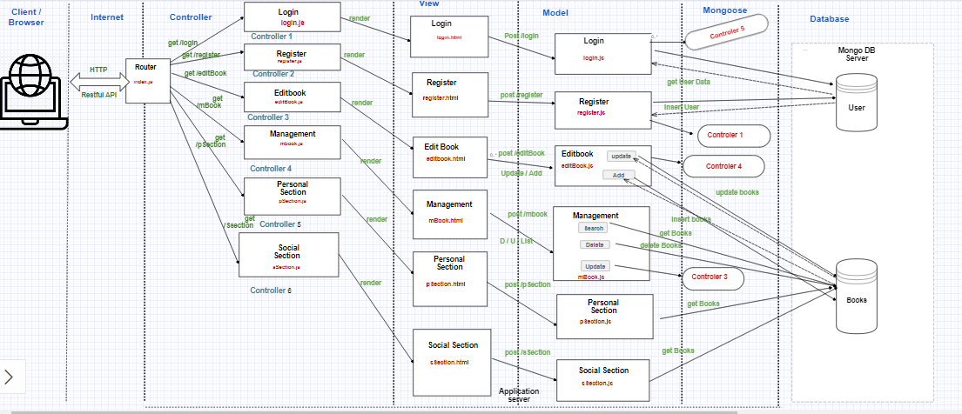

Slide 9
REQUIREMENTS
1) User Sign In and adding books:
Functions : login() - Logging into the application.
register() – Registering new user
create() - Adding a book into library
edit() - Editing the book details
delete() - deleting the books

Slide 10
REQUIREMENTS
2) - Forming topics based on metadata tags
- Searching based on that topics.
3) Books Recommendation

Slide 11
LOGIN PAGE
Login Page has Two Main Functionalities :
1) Login
2) Register

Slide 12
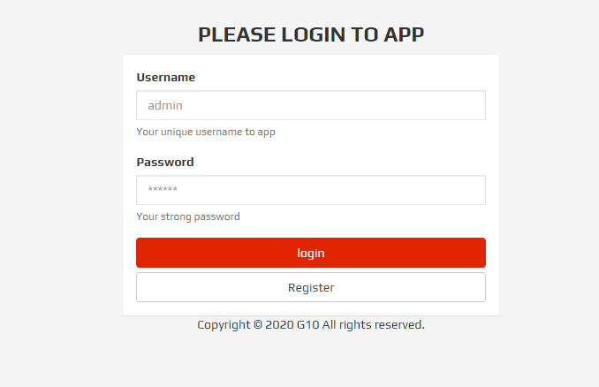
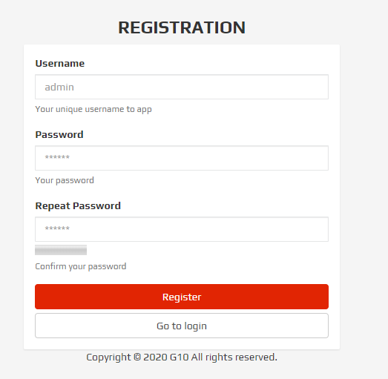
LOGIN PAGE

Slide 13
LOGIN PAGE
Login.html (HTML, CSS, BootStrap)
- User Input : User Name and Password
Login.js (JavaScript, AJAX, Mongoose, Express)
- Validation Success
Render to Personal Section
- Validation Failure
Render to same page with Error Message

Slide 14
PERSONAL SECTION
Personal Section :
1) This section holds the list of books available in personal section
2) In addition to that it has customized search where we can able to search the books based on topics.

Slide 15
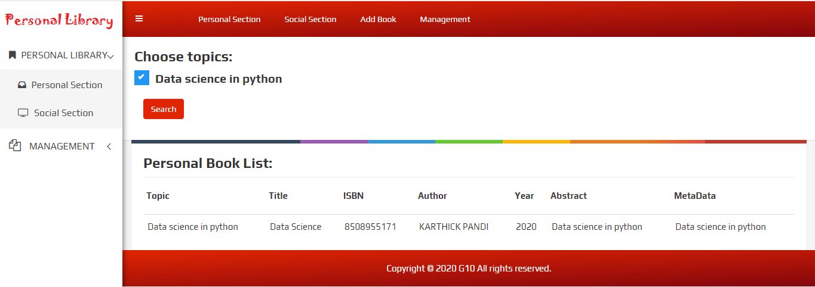
PERSONAL SECTION

Slide 16
SOCIAL SECTION
Social Section :
1) This section holds the list of books available in social section
2) In addition to that it has customized search where we can able to search the books based on topics.

Slide 17
SOCIAL SECTION
Social Section :
3) Book Recommendation:
User can able to view other user books if they share atleast three books in common.

Slide 18
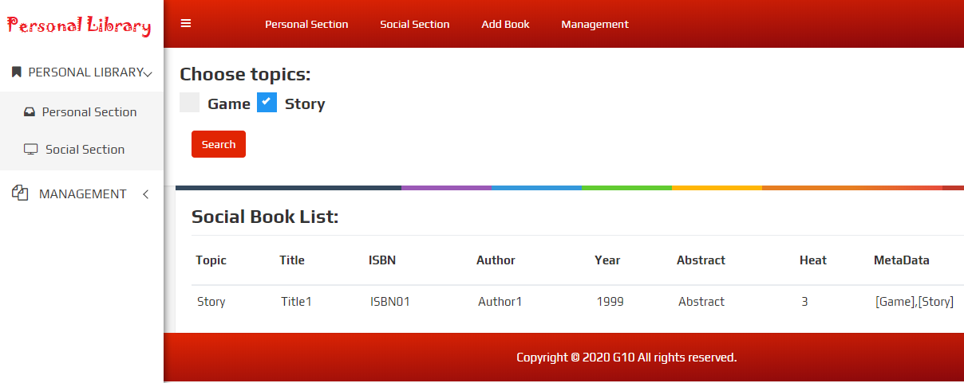
SOCIAL SECTION

Slide 19
ADD BOOK
Add Book :
1) Here we can add books to this library .The fields which required to add the books includes:
Title
Author
Public Year
ISBN
Abstract
Metadata

Slide 20
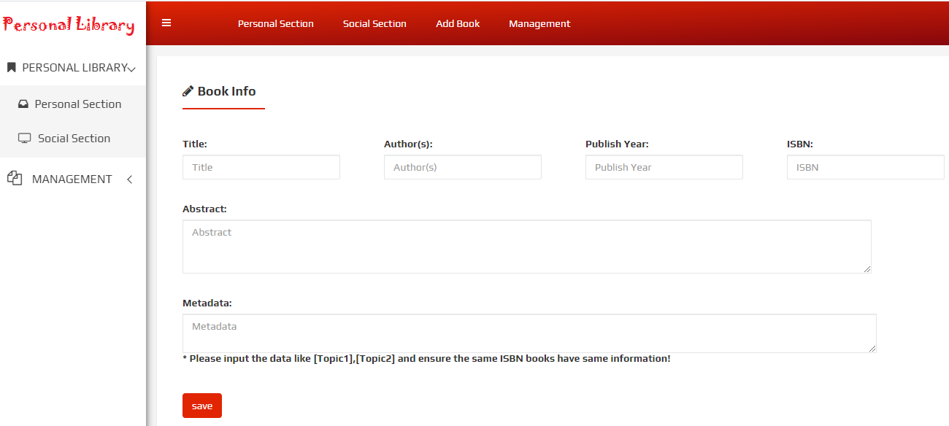
ADD BOOK

Slide 21
BOOK MANAGEMENT
Book Management :
1) Customized search based on Title,
Author Name, Published Year and ISBN

Slide 22
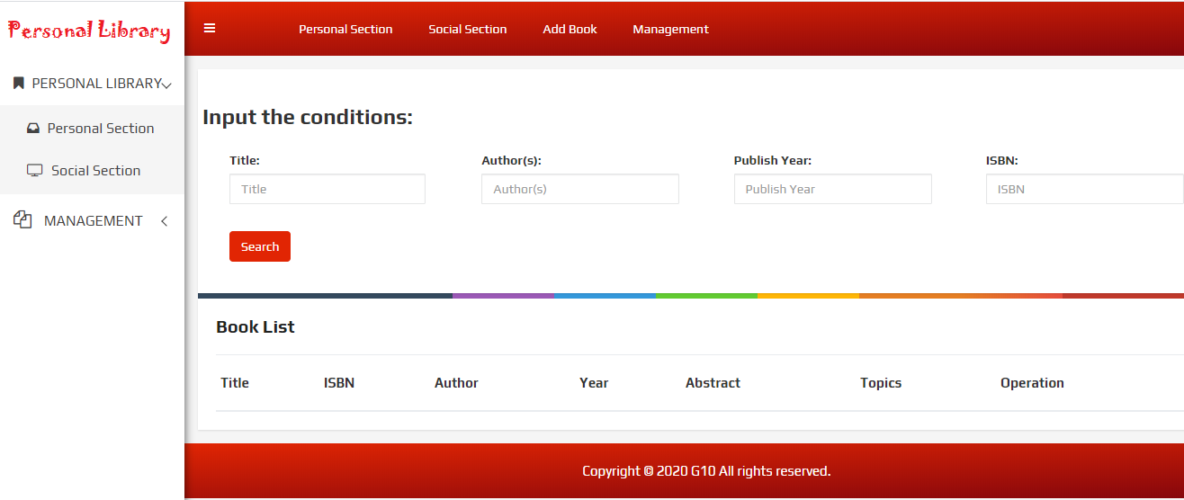
BOOK MANAGEMENT

Slide 23

WEB HOSTING

Slide 24
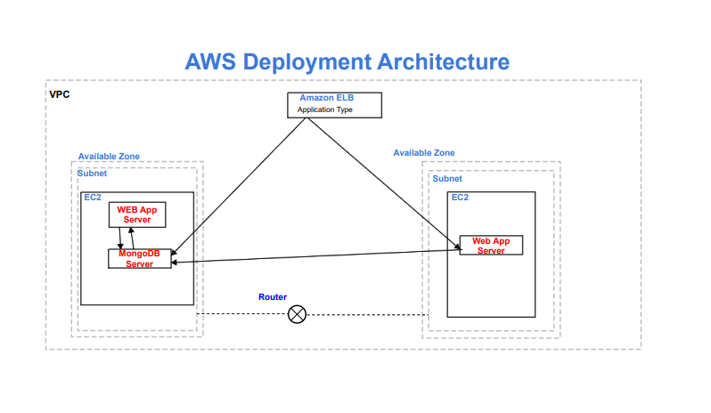
APP DEPLOYMENT

Slide 25
APP DEPLOYMENT
AMAZON ELB ( Elastic Load Balancing ) :
For Consistence Application Performance
EC2 : Virtual Server
Available Zone: Data Center

Slide 26
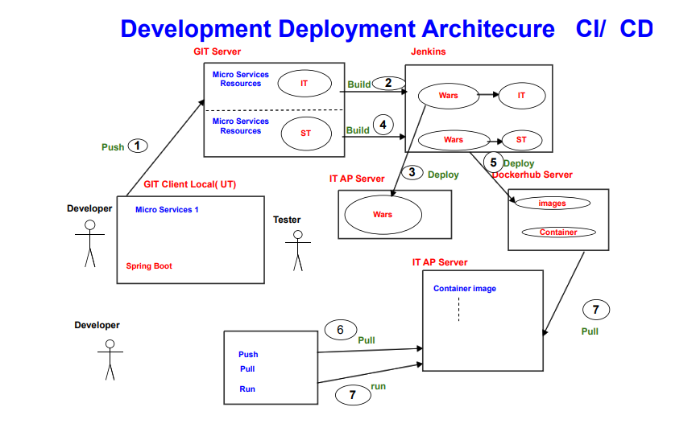

Slide 27


